Slide 1
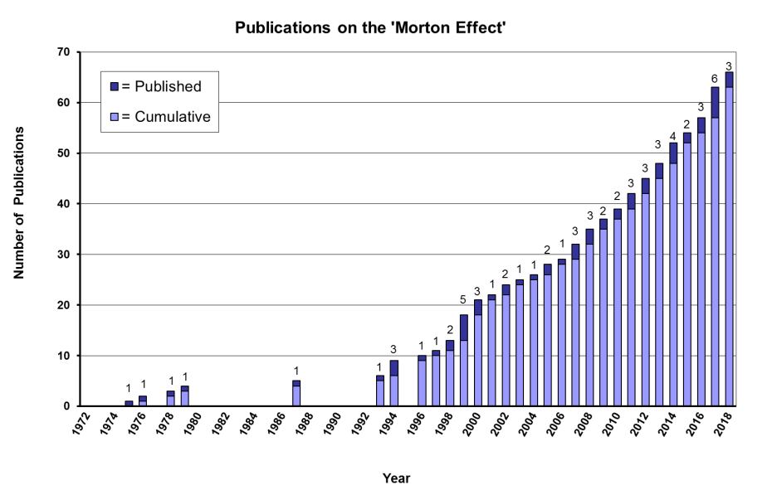

Slide 2
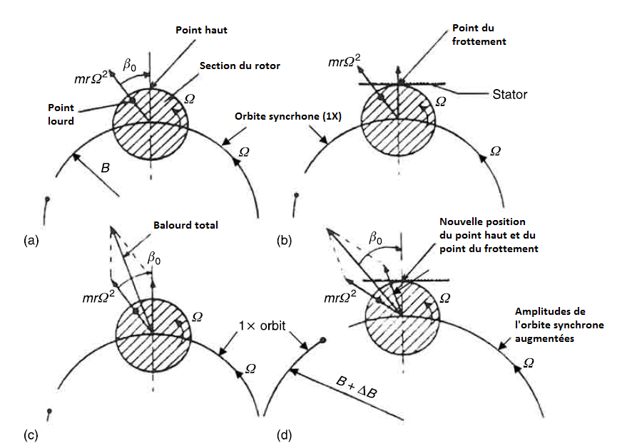



$$F_{U_{th}}$$
$$F_{U_{th}}$$
$$F_{U_{th}}$$

